Slide 1

CREDIT CARD DEFAULT PREDICTIONS
By: Jose Antonio Villegas
Coding Dojo Student
03/25/2022

Slide 2


Slide 3
Project Description
The purpose or goal of this project is to predict consumers who default on their credit card payments based on variables on data gathered.
Data consists of 13,444 observations and 14 variables.
:Data Source: https://www.kaggle.com/surekharamireddy/credit-data

Slide 4
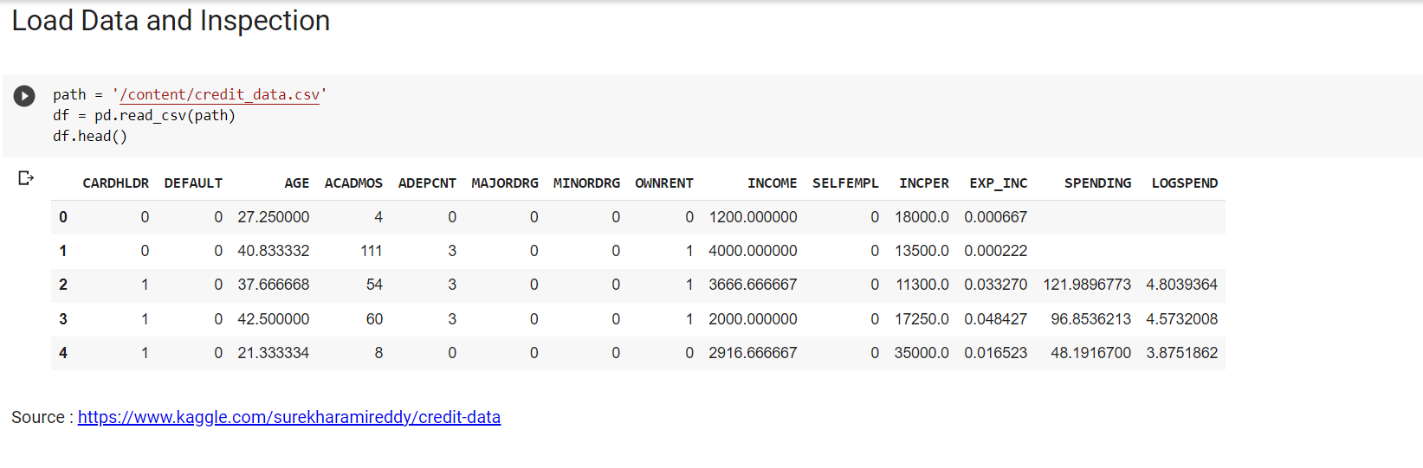

Slide 5
Description of Data
CARDHLDR 1 if application for credit card accepted, 0 if not
DEFAULT 1 if defaulted 0 if not (observed when CARDHLDR=1, 10,499 observations)
AGE Age in years plus twelfths of a year
ACADMOS months living at current address
ADEPCNT number of dependents
MAJORDRG Number of major derogatory reports
MINORDRG Number of minor derogatory reports
OWNRENT 1 if owns their home, 0 if rent

Slide 6
Description of Data….continuation
INCOME Monthly Income (divided by 10,000)
SELFEMPL 1 if self employed, 0 if not
INCPER Income divided by number of dependents
EXP_INC Ratio of monthly credit card expenditure to yearly income
SPENDING Average monthly credit card expenditure (for CARDHLDR = 1)
LOGSPEND Log of spending

Slide 7
Cleaning Data
There are no zero (0) null values on the dataset
No duplicates were found
Dropped three (3) columns:
CARDHLDR : As description states, this ‘title’ is given to person if credit card application is accepted. To be able to use this data, they should already be cardholders.
LOGSPEND : ‘Log of Spending’ - not much information at to what this data is for.
SPENDING : Again, this data column has information based on CARDHLDR application, accepted or not.

Slide 8
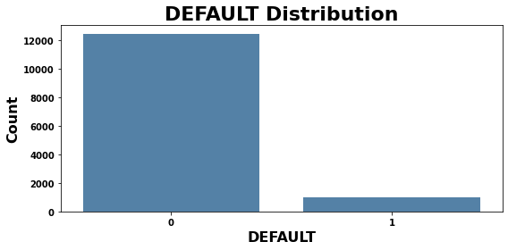
Initial finding on features of the data shows higher number probability of cardholders not to default on their credit card payment.

Slide 9
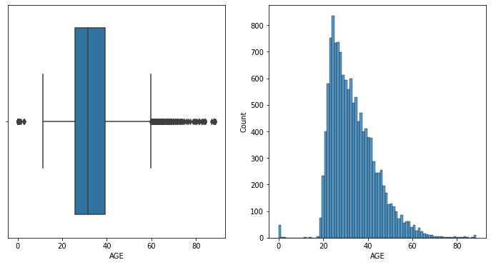
During initial analyzation of data, ‘AGE’ showed a number of outliers that had to be researched upon.
Minimum age for card holders = 18 yrs old
First credit card introduced 1950’s
Not much information from Kaggle as well.
Decided not to drop

Slide 10
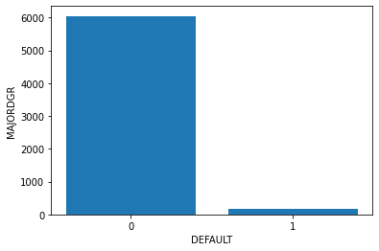
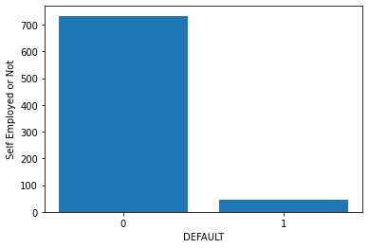
Most features of Dataset were imbalance which leaned most towards credit card holders not defaulting. These are just two samples from Major Derogatory Reports and Self- Employed or Not credit card holders.

Slide 11
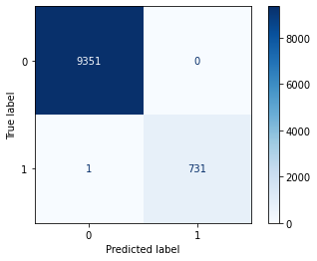
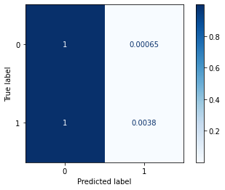
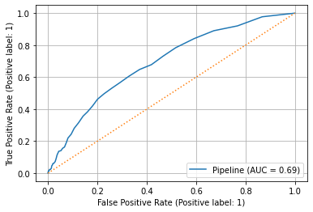
Random Forest Model is recommended due to having the highest Train/Test Accuracy score of .93/.92 respectively.

Slide 12
Conclusion / Recommendation:
The Dataset had inconsistencies that default payment for credit card holders would not be as accurate as we want. Dataset had inaccuracies and uncertainty in the variables as stated in the description/content of the data gathered by the bank. The heatmap showed as well the weak correlation between features and the target.
Recommendations :
Collection of verified/accurate data.
Add/incorporate additional features/information that could be real/actual reason behind default.
Information regarding ‘AGE’ be confirmed.

